Slide 1


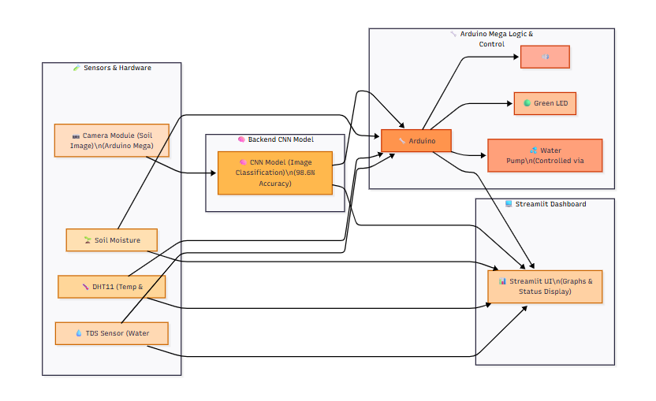
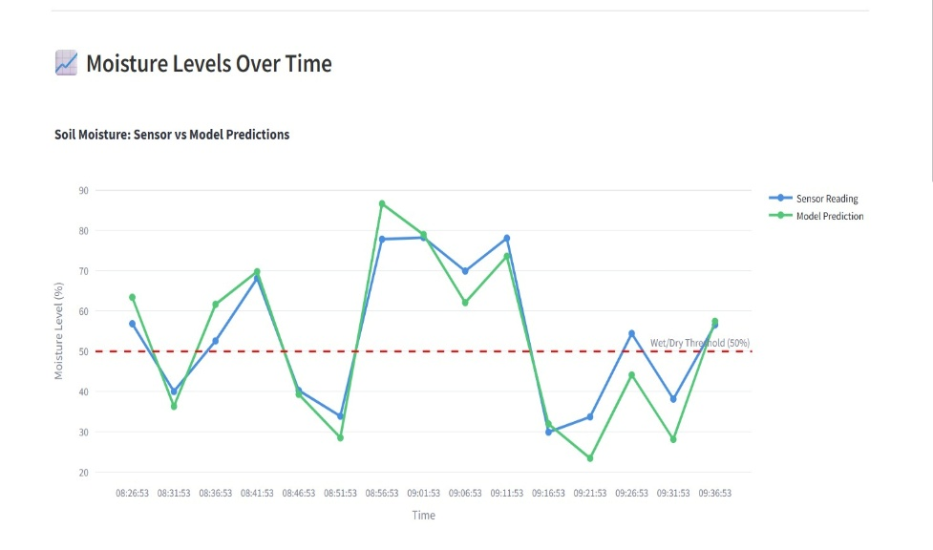
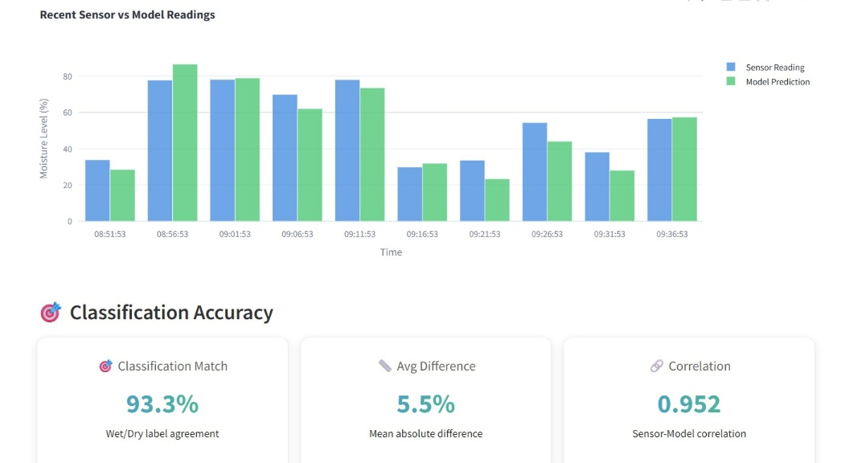
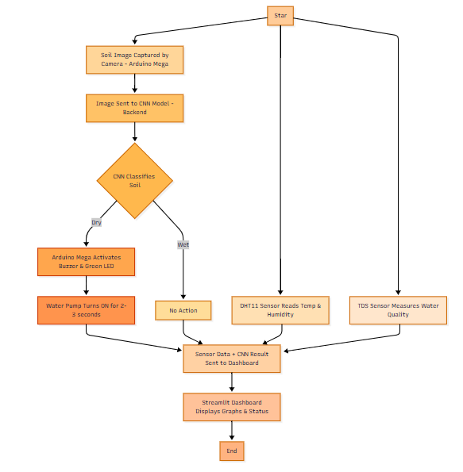
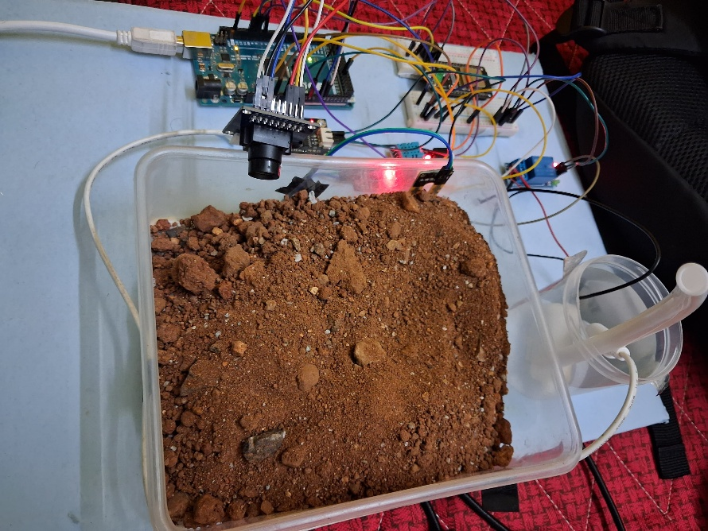
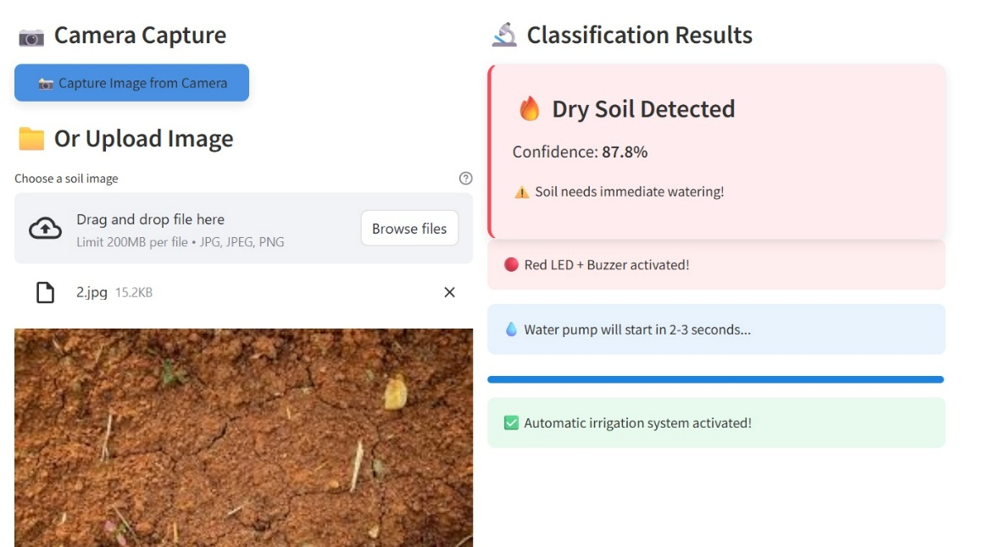


VI SEMESTER INTERDISCIPLINARY PROJECT
Go, change the world
Smart Irrigation system with soil monitoring & ML for sustainable agriculture
Arun Kumar G.V. | Hrushikesh Koli. | Susheel S Talwar. | Kishore Kumar K S. | Tejas Soham.
1RV23IS401 | 1RV22IS022 | 1RV23ME410 | 1RV23ME405 | 1RV22IS074
Abstract
Experimentation/Hardware/Software model
The project presents the development of a Smart Irrigation System integrating a CNN-based image classification model, IoT sensors, and wireless control for efficient water management. A backend CNN model trained on 400 soil images achieves 98.6% accuracy in identifying soil moisture levels from real-time images captured via a camera connected to Arduino Mega. The result is sent to an ESP32, which controls a pump, buzzer, and LED accordingly. DHT11 and TDS sensors monitor temperature, humidity, and water quality, with data visualized on a React-based dashboard through graph comparisons of CNN output and sensor readings. The system promotes sustainable agriculture through intelligent automation and real-time soil monitoring.
Problem Statement
Block Diagram
Results and Analysis
Conventional irrigation methods lack real-time monitoring, leading to inefficient water usage and poor crop health. This project addresses the need for an intelligent system that uses machine learning and IoT to automate irrigation based on soil and environmental conditions.
Automated pump activation (2–3 sec) triggered after buzzer alert for dry soil conditions.
Real-time dashboard updates (<1s latency) visualize sensor and model data simultaneously.
Graphical comparison of CNN output and sensor readings (moisture, temperature, TDS).
Water quality monitoring (TDS: 420 ppm) helps assess irrigation water purity and toxicity.
Temperature readings (DHT: 30.1 °C) match closely with field conditions (29.8 °C), validating sensor accuracy.
Humidity levels (DHT: 61%) reflect accurate real-time environment sensing for localized decisions.
Soil moisture classification via CNN with 98.6% accuracy enables precise irrigation decisions.
Objectives
To classify soil moisture status using a CNN model trained on soil images.
To monitor temperature, humidity, and water quality using IoT sensors.
To develop a smart irrigation system that automates watering based on soil condition.
To control irrigation components (pump, buzzer, LED) based on model output.
To visualize real-time data and comparisons through a Streamlit-based dashboard.
Methodology
Sensor vs Model Predictions
Classification Accuracy
Smart irrigation model
Live Sensor Data
Outcome
Achieved 98.6% accuracy using CNN trained on dry/wet soil images.
Real-time environmental monitoring using DHT11 and TDS sensors.
Wireless data transmission to a React dashboard for visualization and comparison.
Smart irrigation prototype with ML-powered soil classification built.
Promotes sustainable agriculture through intelligent automation and soil health insights.
Methodology
A camera module connected to an Arduino Mega captures a real-time image of the soil.
The captured image is sent to a Convolutional Neural Network (CNN) model hosted on a backend server.
The classification result is sent back to the Arduino Mega for further action.
If the soil is classified as dry, the Arduino Mega:
Activates a buzzer for 3 seconds.
The CNN model, trained on 400 images, classifies the soil as wet or dry.
Turns on a green LED.
Turns on the water pump for 2–3 seconds after the buzzer.
Simultaneously, the DHT11 sensor records temperature and humidity data.
A TDS sensor measures the purity of irrigation water to detect contamination or excessive salinity.
All sensor data and CNN classification results are sent to a Streamlit-based dashboard for visualization.
The dashboard displays real-time graphs and comparisons of sensor data vs. model output.
This system enables automated irrigation and informed decision-making, contributing to sustainable and efficient farming practices.
References
A. Wagh, S. Kothari, and P. Patil, “Smart irrigation system using IoT and machine learning,” International Journal of Engineering Research & Technology (IJERT), vol. 9, no. 5, pp. 162–166, May 2020.
R. K. Kodali, B. S. Yerroju, “IoT based smart irrigation system using soil moisture sensors,” in 2016 IEEE Region 10 Symposium (TENSYMP), Bali, Indonesia, pp. 343–346, May 2016. doi: 10.1109/TENCONSpring.2016.7519432
T. S. Bhosale and P. G. Patil, “Soil moisture prediction using deep learning,” International Journal of Scientific Research in Computer Science, vol. 6, no. 2, pp. 42–47, 2019.
R. Priya, N. Sivaranjani, and D. Jayanthi, “Smart irrigation system using IoT and cloud computing,” Materials Today: Proceedings, vol. 45, pp. 2290–2296, 2021. doi: 10.1016/j.matpr.2020.10.639
H. Patel and M. Patel, “Analysis of TDS sensor for smart water quality monitoring,” International Research Journal of Engineering and Technology (IRJET), vol. 6, no. 4, pp. 4521–4524, Apr. 2019.
D. Kumar and D. K. Jain, “Smart irrigation system and soil moisture monitoring using IoT,” International Journal of Engineering Science and Computing, vol. 8, no. 7, pp. 18073–18076, Jul. 2018.
J. N. Patil and V. Y. Shinde, “Soil classification using deep learning for smart agriculture,” International Journal of Advanced Research in Computer and Communication Engineering, vol. 7, no. 6, pp. 192–196, Jun. 2018.
A. Jain, R. Sharma, and P. Joshi, “Automated irrigation system using IoT,” International Journal of Computer Applications, vol. 180, no. 37, pp. 26–30, May 2018. doi: 10.5120/ijca2018917303
M. A. Basha and R. P. Kumar, “Design and implementation of automated irrigation system using IoT,” Journal of Engineering Science and Technology (JESTEC), vol. 13, no. 12, pp. 4220–4231, Dec. 2018.
R. Singh and S. N. Deepa, “Implementation of convolutional neural network-based soil classification for precision farming,” Procedia Computer Science, vol. 167, pp. 1742–1750, 2020. doi: 10.1016/j.procs.2020.03.389
Signature
Prof. Rakesh Kumar.
Assistant Professor Department of Mechanical Engineering
Notes:
1

